Slide 1
React
Defining routes

Slide 2

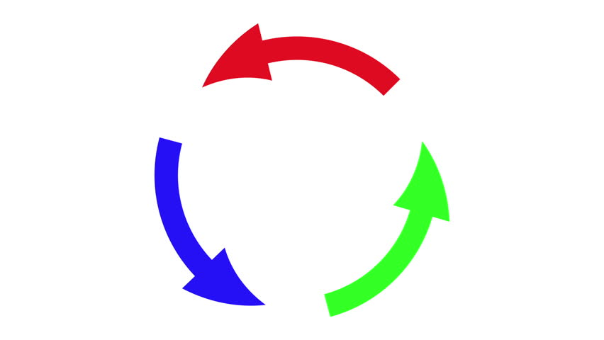
Import and Export
Flour.js
Milk.js
Butter.js
Circular import is not allowed

Slide 3

Import and Export
Butter.js
Milk.js
Flour.js
Sequential import is allowed

Slide 4
Today’s Lecture
React States and Props
Controlled and Uncontrolled Elements

Slide 5
Using Styles
const style = {
backgroundColor:’grey’,
border:’1px solid green’
}
render(){ <div style={style}></div> }

Slide 6
Controller and Uncontrolled Elements
Controlled Element
<input type=“text” value={this.state.name} onchange=“this.onChange” />
Examples>
1). Instant field validation
2). Conditionally disabling submit button
Uncontrolled Element
<input type=“text” onchange=“this.onChange” />
Examples>
1).One-time value retrieval
2).Validating on submit

Slide 7
Setting default value
<input type=“text” defaultValue={state.name} />

Slide 8
Default props for components
class Datepicker extends React.Component {
}
Datepicker.defaultProps = {
startFrom:’1/9/2017’,
}
Example>
<Datepicker startFrom=’26/11/17’ />

Slide 9
Define a component
export const Header = ()=>{
return <div>
</div>
}

Slide 10
Routes
A standardized way to divide the site content into logical sections and categories.
Example>
/about
/dashboard/products
/dashboard/transactions
/logout

Slide 11
Routes
HOME
LOGIN
DASHBOARD
Router View

Slide 12
Routes
HOME
LOGIN
DASHBOARD
HOME CODE

Slide 13
Routes
HOME
LOGIN
DASHBOARD
LOGIN CODE

Slide 14
Routes
HOME
LOGIN
DASHBOARD
DASHBOARD CODE

Slide 15
Routes in React
The root component should render the Router component
Import { BrowserRouter } from ‘react-router-dom’;
App{
render(){
<BrowserRouter>
//Rest of the code </ BrowserRouter >
}
}

Slide 16
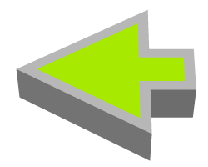
Routes in React
<Router>
<Link to=‘/login’> Login</Link> <Link to=‘/signup’> </Link> <Link to=‘/contact’ > </Link>
</Router>
<Route path=‘’/login’ component={loginComponent} />
<Route path=‘’/signup’
component={signupComponent} />
<Route path=‘’/contact’
component={contactComponent} />

Slide 17

Changing routes programmatically
this.props.history.push(‘/login’)

Slide 18
Data Bindings
Bi-directional data binding
Data flows only in both directions
Unidirectional data binding
Data flows only in one direction

Slide 19
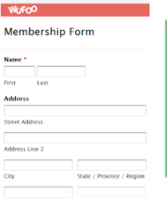
Models and Views
Model
View
JS code to handle the state of data

Slide 20
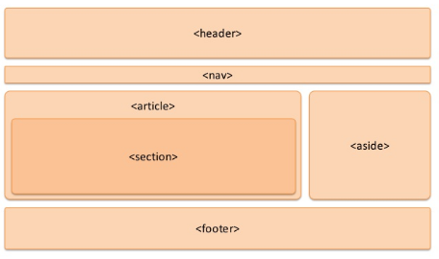

Cross component data sharing
Communication and syncing of data between components is
essential for a fully functional
React-Powered application. How to do this?

Slide 21
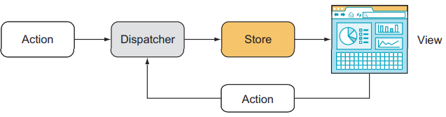
Solution, Flux!

Slide 22



Summarized Solution
Header Component
Login Component
Store
Contact Component
Dashboard Component

Slide 23


Store and actions
signInAction
Header Component
Reducers
Store
creaetePostAction
Dashboard Component

Slide 24
Getting started with react-redux
React-Redux is a popular library for inter-component communication.
It contains actions were each action corresponds to a user action e.g. signin, fetchProducts, showTransactions etc.

Slide 25
Create redux store
Create a redux store.
import { createStore } from 'redux';
const store = createStore(reducer)
//Reducer is simply a function which returns the updated data
To the store based on different conditions. We generally use multiple reducers
based on application functionality. e.g. signin reducers, products reducers,
Store

Slide 26

Redux Connector
We need the redux connector to make
our component connected with redux store.
Store
import { connect } from 'react-redux'; export default connect(importData, defineActions)(Header)
//Header is our component class
Header Component

Slide 27
REducer
const signInReducer = (state = initialState, action) => {
switch (action.type) {
case ‘SIGNING_IN’:
return { loggingIn: true};
case ‘SIGNING_SUCCESSFUL’:
return { loggedIn: true};
case ‘SIGNING _FAILED’:
return { loggedIn: false};
default:
return state;
} }
Show progress bar while signing-in
Move the user from sign-in to dashboard
Show the type of failure to the user e.g.
network error, validation error etc.
export default connect(importData, defineActions)(Header)
//this.props.loggingIn, this.props.loggedIn,

Slide 28

Context API
This new API solves one major problem –prop drilling.
Prop drilling is the processing
of getting data from parent component
to child component by passing it through
multiple layers of intermediary React components

Slide 29
Context API
UserProvider
ChatboxProvider
TimeLineProvider
Dashboard Component
Timeline Component

Slide 30
Context API
Redux | Context API
Predefined structure makes it easy to fit in almost every project | May need to be designed differently for each project
Needs to be installed separately, sometimes version of React and react-redux need to be synced | It is built-in in React, therefore no extra library is needed.
It is internally faster performance wise | Context API is slow compared to Redux

